Slide 1

ISPASS’25@Ghent
Dissecting Performance Overheads of Confidential Computing in GPU-based Systems
Yang Yang, Mohammad Sonji, Adwait Jog
{yangyang, npv2tk, ajog} @virginia.edu
Insight Computer Architecture Lab
Notes:
Hi, my name is Yang Yang.
Today, I will present our work “Dissecting Performance Overheads of Confidential Computing in GPU-based Systems”
This work was performed with my colleague Mohammad Sonji and my advisor Adwait Jog at University of Virginia

Slide 2
ISPASS’25@Ghent
Executive Summary
Problem:
Confidential Computing with GPU is emerging
Existing work lacks detailed performance dissection
Optimization insights remain unclear due to limited characterization
Goal: Dissect the performance overheads of GPU-based confidential computing that can motivate various optimizations to address them.
Our results on real hardware show that GPU-based CC comes with:
Data Movement Overhead (up to 19.7×)
Low Encryption Throughput (3.36 GB/s)
Kernel Execution Time (up to 164,030.65× with UVM)
Kernel Launch Overhead (up to 5.31×)
Queueing (1.43× and 2.23× on average)
Fusion, overlapping and quantization
https://github.com/insight-cal-uva/hcc-ispass25-artifact
Notes:
First, let's have an executive summary.
The problem is confidential Computing with GPU is emerging. But existing work lacks detailed performance dissection
Therefore, optimization insights remain unclear, due to limited characterizations.
Our goal is to dissect the performance overhead of GPU-based confidential computing, that can motivate various optimizations to address them.
We showed on real hardware that GPU based CC came with overhead from
data movement,
encryption,
execution
launch and queueing.
And these observations lead to optimization insights, including fusion, overlapping and quantization.
Our artifact is available at this link.

Slide 3
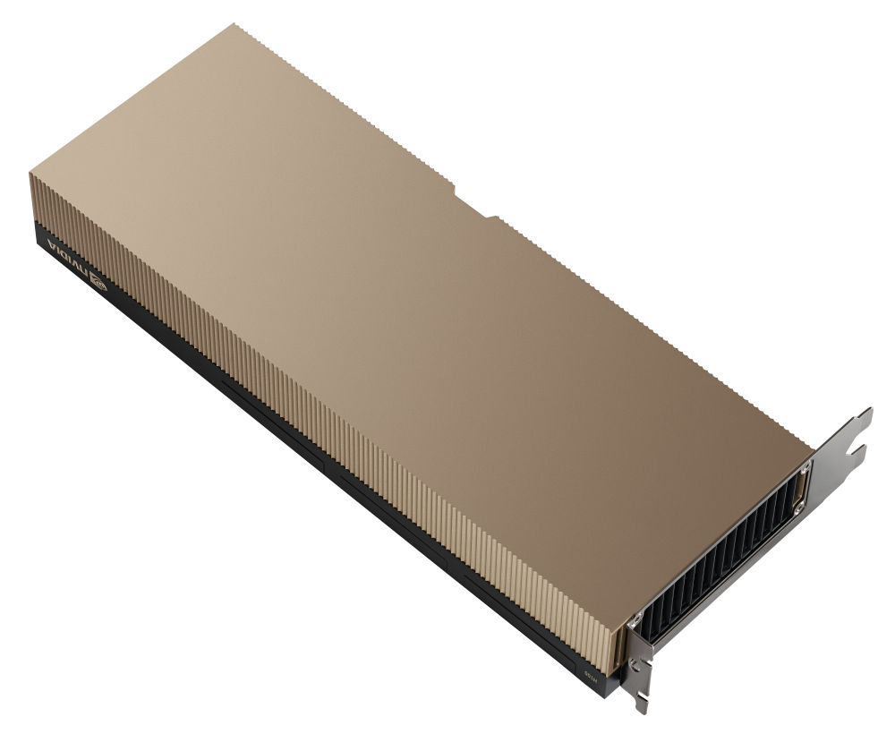
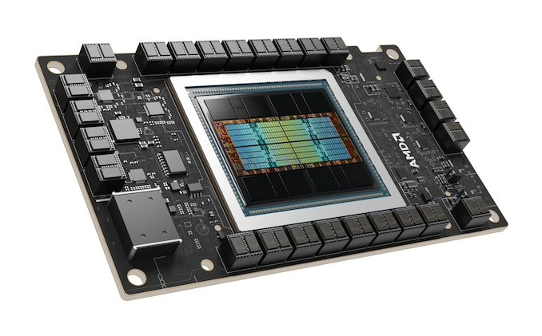
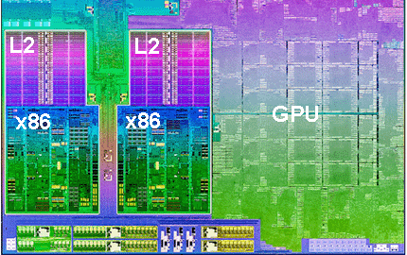
Graphics Processing Units (GPUs)
DL/ML/AI
Graphics
HPC
Crypto
Graphs
Genomics
Abundant Data and Task-level Parallelism
Credit/Source: AMD, NVIDIA, Wiki
High Throughput + Energy Efficiency
Introduction
Background
Performance Model
Evaluation
3
Conclusion
Notes:
In recent years, there is growing need for accelerating applications from different domains. Most popular one is Deep Learning and AI.
GPUs are perfect match for these workloads because they have higher fraction of silicon for computation than CPU.
However, as we process these massive amounts of data, new challenges emerge — particularly in ensuring privacy and security.

Slide 4



Needs for Security and Privacy
Data is Private
Client privacy (chat bot, …)
Regulated (GDPR, PII, …)
Data is Massive
Outsource compute & data to public cloud Infra.
Can cloud service providers be trusted?
Introduction
Background
Performance Model
Evaluation
4
Conclusion
Notes:
Some data is inherently private and might be protected by regulations such as GDPR.
The scale of data and
compute demands
quickly exceeds local capabilities.
As a result, users outsource both their data and computation to the cloud to leverage its resources.
But this raises a critical question: <Click> Can we trust cloud service providers?
The answer is no — existing attacks have shown that cloud infrastructures cannot be fully trusted.

Slide 5
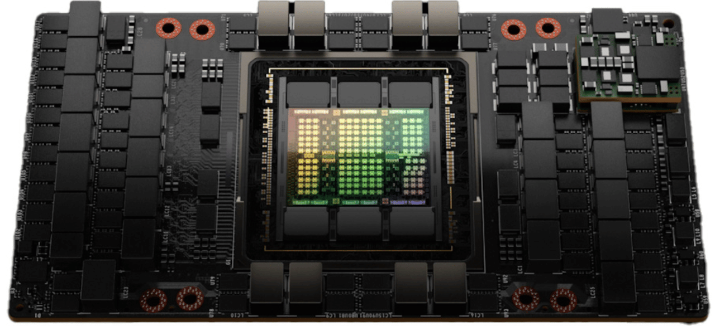
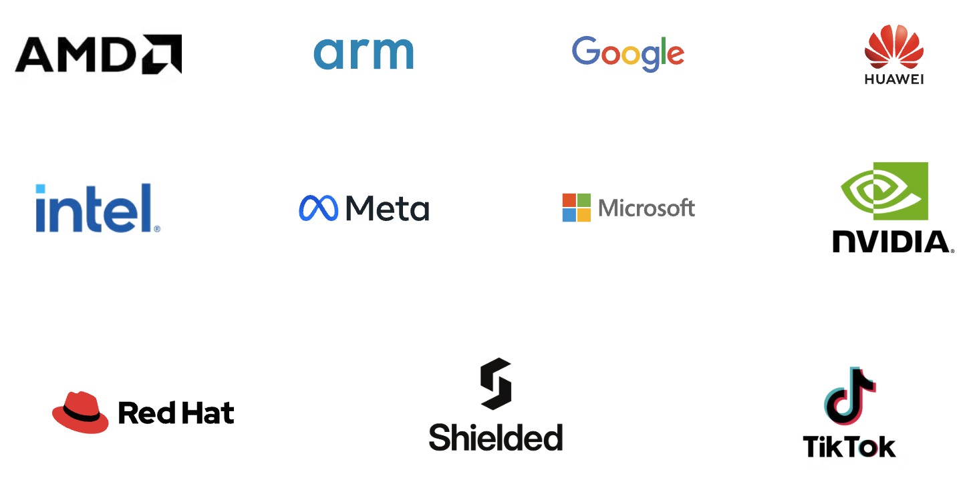


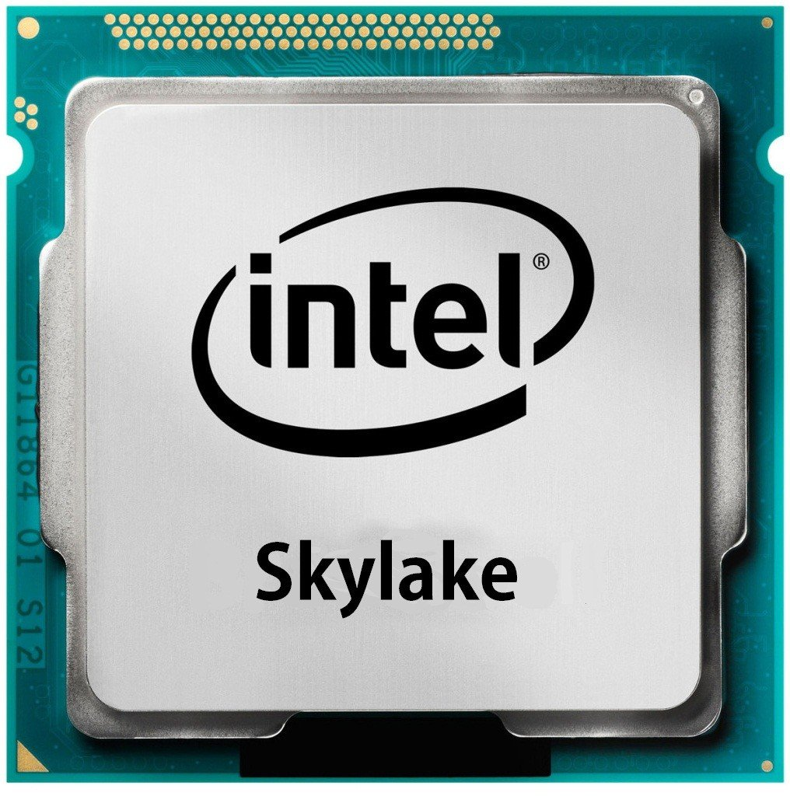
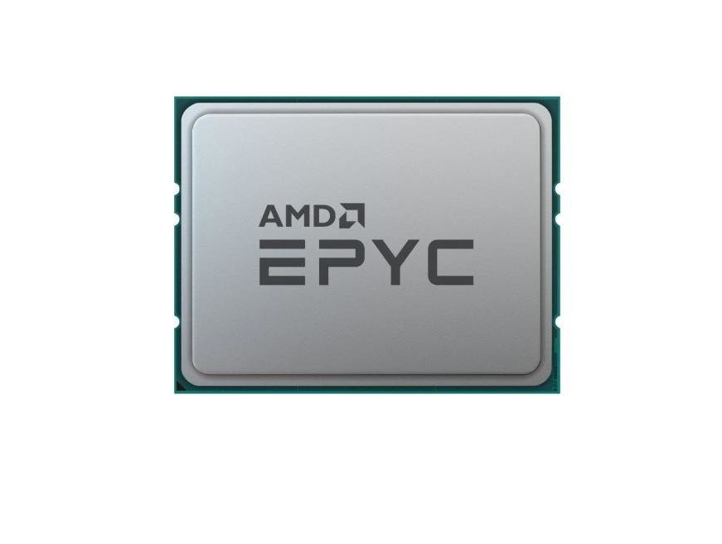

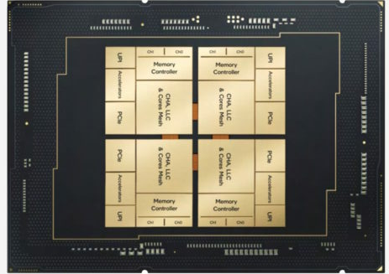

Trusted Computing
The first
commercial GPU TEE
NVIDIA
HCC
2023
Intel
TDX
2020
CPUs With TDX
ARM
TrustZone
2002
Intel
SGX
2015
AMD
SEV
2016
CC
Consortium
2019
AMD
SEV-SNP
2020
ARM
CCA
2021
Intel
SPR
2023
Intel
EMR
2023
RISC-V
KeyStone
2019
RISC-V
Penglai
2020
VM-based
Isolation
GPU-based CC
Credit/Source: ARM/INTEL/AMD/CCC/RISC-V/NVIDIA/Wiki
Introduction
Background
Performance Model
Evaluation
5
Conclusion
Notes:
To address these trust concerns, both industry and academia have invested heavily in trusted computing or trusted-execution environment (TEE), and more recently this term evolved to confidential computing.
In 2002, ARM proposed TrustZone, which brings hardware-enforced isolations
Intel proposed SGX, which adopts enclave-based isolation and memory encryption
It has been studies for so many years until now
in 2016, AMD proposed SEV shifting the focus toward VM-based isolation.
Since then, most industry solutions have adopted VM-based isolation.
<click> In 2019, the Confidential Computing Consortium was established and many company were involved
Shortly after, we saw new designs like Intel TDX, AMD SEV-SNP, and ARM CCA around 2020–2021, bringing confidential computing to the stage.
In 2023, two major milestones arrived:
<click> Intel shipped the first CPUs with TDX support, and <click> NVIDIA introduced HCC, the first commercial GPU TEE.
Confidential computing has evolved from mobile devices, to CPUs, and now to GPUs.

Slide 6
Confidential Computing
Trust
boundary
CPU Package
Cores
LLC
PCIe
AES-NI
iMC
MEE
(TME-MK)
Hardware Platform
MEE: Memory Encryption Engine
Introduction
Background
Performance Model
Evaluation
6
Conclusion
Notes:
Then let’s introduce the background of CC.
First, the CPU is within the trust boundary.
it can perform memory encryption through a dedicated memory encryption engine (or MEE) resides in memory controller.
CPU cores can also perform AES with specialized instructions.

Slide 7


Confidential Computing
Trust
boundary
CPU Package
Cores
LLC
PCIe
AES-NI
iMC
MEE
(TME-MK)
DDR
Hardware Platform
MEE: Memory Encryption Engine
Introduction
Background
Performance Model
Evaluation
7
Conclusion
Notes:
Then we need to encrypt the DDR memory connected with the CPU through this engine.

Slide 8
Confidential Computing
Traditional VM
Trust Domain
Isolation
APP
APP
Trust
boundary
OS
OS(+TDX)
Hypervisor
TDX Module
CPU Package
Cores
LLC
PCIe
AES-NI
iMC
MEE
(TME-MK)
DDR
Hardware Platform
MEE: Memory Encryption Engine
Introduction
Background
Performance Model
Evaluation
8
Conclusion
Notes:
Now we can launch the virtualization stacks.
We have traditional virtual machine, which is managed by the Hypervisor.
We also have this new type of VM called trust domain which is managed by a trust software component called TDX module.
and there is isolation between different types of VMs.

Slide 9
Confidential Computing with GPU
Traditional VM
Trust Domain
Isolation
APP
APP
Trust
boundary
OS
OS(+TDX)
Hypervisor
TDX Module
Cores
LLC
PCIe
PCIe
Compute
Engines
HBM
AES-NI
iMC
MEE
(TME-MK)
DDR
GMMU
CPU Package
Hardware Platform
GPU Package
MEE: Memory Encryption Engine
Introduction
Background
Performance Model
Evaluation
9
Conclusion
Notes:
Now, we're trying to connect GPU with into this stack.
Once we plugged the GPU, we can set it to confidential computing mode, and passthrough it to the TD

Slide 10
Confidential Computing with GPU
Traditional VM
Trust Domain
Isolation
APP
APP +
CUDA
Trust
boundary
OS
OS(+TDX)
Hypervisor
TDX Module
Cores
LLC
PCIe
PCIe
Compute
Engines
HBM
AES-NI
iMC
MEE
(TME-MK)
DDR
GMMU
CPU Package
Hardware Platform
GPU Package
MEE: Memory Encryption Engine
Introduction
Background
Performance Model
Evaluation
10
Conclusion
Notes:
because of the VM-level isolation, we can install cuda as usual

Slide 11

Confidential Computing with GPU
Traditional VM
Trust Domain
Isolation
APP
APP +
CUDA
Trust
boundary
OS
OS(+TDX)
Hypervisor
TDX Module
Cores
LLC
PCIe
PCIe
Compute
Engines
HBM
AES-NI
iMC
MEE
(TME-MK)
DDR
GMMU
CPU Package
Hardware Platform
GPU Package
MEE: Memory Encryption Engine
Introduction
Background
Performance Model
Evaluation
11
Conclusion
Notes:
the communication over the untrusted PCIe will be encrypted.
because of the lack of dedicated AES engines,
<click> This encryption will go through the CPU cores with the help of AES instructions for acceleration.

Slide 12
Confidential Computing with GPU
Communication (MMIO/DMA) will trigger #VE, TD will context-switch
Traditional VM
Trust Domain
Isolation
APP
APP +
CUDA
Trust
boundary
OS
OS(+TDX)
Hypervisor
TDX Module
LLC
PCIe
DMA/MMIO
Cores
PCIe
Compute
Engines
HBM
AES-NI
iMC
MEE
(TME-MK)
DDR
GMMU
CPU Package
Hardware Platform
GPU Package
MEE: Memory Encryption Engine
Introduction
Background
Performance Model
Evaluation
12
Conclusion
Notes:
whatever happens over the PCIe Bus will be encrypted, which, including the DMA and MMIO operations.
<click> Once GPU received the data, it will be decrypted and stored in HBM.
<click> Such communication with GPU will trigger virtual exception which will cause the context switch from Trust Domain to hypervisor.
Though there have been research to build GPU TEEs, H100 CC is the first commercialized GPU TEE.
Therefore, detailed performance dissection is crucial but not there before.

Slide 13
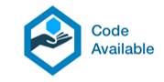
Real World Setup
https://github.com/insight-cal-uva/hcc-ispass25-artifact
CC-capable CPUs: support TDX or SEV-SNP
H100 is the first GPU that supports CC.
Problem:
Confidential Computing with GPU is emerging
Existing work lacks detailed performance dissection
Optimization insights remain unclear due to limited characterization
Introduction
Background
Performance Model
Evaluation
13
Conclusion
Notes:
Guided by the problems,
<click> we set up real hardware to dissect its performance.
The detailed configuration is listed in the table.

Slide 14
Performance Model
ALLOC
Introduction
Background
Performance Model
Evaluation
14
Conclusion
Notes:
Now we introduce a simple model to better understand the performance.
We focus on cuda applications in general.
First, you will need to allocate memory on GPU

Slide 15
Performance Model
ALLOC
H2D
H2D: host (CPU) to device (GPU) copy
Introduction
Background
Performance Model
Evaluation
15
Conclusion
Notes:
Then you will need to copy the prepared data from host (or CPU) to device (or GPU), this is also referred as the copy-then-execute model

Slide 16
Performance Model
K₁
ALLOC
H2D
LAUNCH₁
H2D: host (CPU) to device (GPU) copy
Introduction
Background
Performance Model
Evaluation
16
Conclusion
Notes:
Now you can launch a kernel with the kernel launch call

Slide 17
Performance Model
Kernel Queueing Time (KQT)
Kernel Execution Time (KET)
K₁
K₂
ALLOC
H2D
LAUNCH₁
LAUNCH₂
Kernel Launch Overhead (KLO)
Launch Queueing Time (LQT)
H2D: host (CPU) to device (GPU) copy
Introduction
Background
Performance Model
Evaluation
17
Conclusion
Notes:
Multiple kernels can be launched consecutively.
Launch operation itself takes some time which is referred as kernel launch overhead, or KLO for short
there are queuing times between consecutive launches. Which is called launch queueing time or LQT
Once the launch command finished, kernels are injected to GPU task queues, waiting for scheduling and execution. This waiting time is described as kernel queueing time or KQT
lastly, the kernel will execute, which is referred as kernel execution time, KET for short.
Previous presenters have covered some of the terms, thanks to them, I don’t need clarify more.

Slide 18
Performance Model
Kernel Queueing Time (KQT)
Kernel Execution Time (KET)
K₁
K₂
ALLOC
H2D
LAUNCH₁
LAUNCH₂
SYNC
Kernel Launch Overhead (KLO)
Launch Queueing Time (LQT)
H2D: host (CPU) to device (GPU) copy
Introduction
Background
Performance Model
Evaluation
18
Conclusion
Notes:
And now you will need synchronization to wait the GPU finish the task

Slide 19
Performance Model
Kernel Queueing Time (KQT)
Kernel Execution Time (KET)
K₁
K₂
ALLOC
H2D
LAUNCH₁
LAUNCH₂
SYNC
D2H
Kernel Launch Overhead (KLO)
Launch Queueing Time (LQT)
D2H: device (GPU) to host (CPU) copy
H2D: host (CPU) to device (GPU) copy
Introduction
Background
Performance Model
Evaluation
19
Conclusion
Notes:
Then you can copy the results from GPU back to CPU.

Slide 20
Performance Model
Kernel Queueing Time (KQT)
Kernel Execution Time (KET)
K₁
K₂
ALLOC
H2D
LAUNCH₁
LAUNCH₂
SYNC
D2H
FREE
Kernel Launch Overhead (KLO)
Launch Queueing Time (LQT)
D2H: device (GPU) to host (CPU) copy
H2D: host (CPU) to device (GPU) copy
Introduction
Background
Performance Model
Evaluation
20
Conclusion
Notes:
lastly, you free those memory buffers.

Slide 21
Performance Model
Kernel Queueing Time (KQT)
Launch Queueing Time (LQT)
Kernel Launch Overhead (KLO)
Launch Execution Time (KET)
K₁
K₂
ALLOC
H2D
LAUNCH₁
LAUNCH₂
SYNC
D2H
FREE
P = T_{mem} + Σ(KLO+LQT) + Σ[(1-β_{i} )(KET+KQT)] + T_{other}
Time on memory copy
D2H: device (GPU) to host (CPU) copy
H2D: host (CPU) to device (GPU) copy
Introduction
Background
Performance Model
Evaluation
21
Conclusion
Notes:
Therefore, the first term in this model is related to time spent on memory copy operations.
As we mentioned before, this data movement is over PCIe and will be encrypted under CC

Slide 22
Performance Model
Kernel Queueing Time (KQT)
Launch Queueing Time (LQT)
Kernel Launch Overhead (KLO)
Launch Execution Time (KET)
K₁
K₂
ALLOC
H2D
LAUNCH₁
LAUNCH₂
SYNC
D2H
FREE
P = T_{mem} + Σ(KLO+LQT) + Σ[(1-β_{i} )(KET+KQT)] + T_{other}
D2H: device (GPU) to host (CPU) copy
H2D: host (CPU) to device (GPU) copy
Introduction
Background
Performance Model
Evaluation
22
Conclusion
Notes:
The next term is the launch related overhead, we sum up all KLO and LQTs

Slide 23
Performance Model
Kernel Queueing Time (KQT)
Launch Queueing Time (LQT)
Kernel Launch Overhead (KLO)
Launch Execution Time (KET)
β₁
β₂
K₁
K₂
ALLOC
H2D
LAUNCH₁
LAUNCH₂
SYNC
D2H
FREE
P = T_{mem} + Σ(KLO+LQT) + Σ[(1-β_{i} )(KET+KQT)] + T_{other}
D2H: device (GPU) to host (CPU) copy
H2D: host (CPU) to device (GPU) copy
Introduction
Background
Performance Model
Evaluation
23
Conclusion
Notes:
Then, we take the kernels into consideration.
kernel execution can be overlapped, therefore we assign each kernel an overlapping parameter beta
And then we sum up all kernel queueing time and kernel execution time with respect to the beta

Slide 24
Performance Model
Kernel Queueing Time (KQT)
Launch Queueing Time (LQT)
Kernel Launch Overhead (KLO)
Launch Execution Time (KET)
β₁
β₂
K₁
K₂
ALLOC
H2D
LAUNCH₁
LAUNCH₂
SYNC
D2H
FREE
P = T_{mem} + Σ(KLO+LQT) + Σ[(1-β_{i} )(KET+KQT)] + T_{other}
D2H: device (GPU) to host (CPU) copy
H2D: host (CPU) to device (GPU) copy
Introduction
Background
Performance Model
Evaluation
24
Conclusion
Notes:
And lastly, we account the remaining parts in the critical path as term other, like memory allocation, de-allocation, etc.

Slide 25
Performance Model
Kernel Queueing Time (KQT)
Launch Queueing Time (LQT)
Kernel Launch Overhead (KLO)
Launch Execution Time (KET)
P = T_{mem} + Σ(KLO+LQT) + Σ[(1-β_{i} )(KET+KQT)] + T_{other}
D2H: device (GPU) to host (CPU) copy
H2D: host (CPU) to device (GPU) copy
Introduction
Background
Performance Model
Evaluation
25
Conclusion
Notes:
With this model, we have an overview of what should be covered to understand the performance implications.

Slide 26
Performance Model
Kernel Queueing Time (KQT)
Launch Queueing Time (LQT)
Kernel Launch Overhead (KLO)
Launch Execution Time (KET)
P = T_{mem} + Σ(KLO+LQT) + Σ[(1-β_{i} )(KET+KQT)] + T_{other}
Focus of this presentation
Data movement (H2D, D2H, page migration)
Encryption
Kernel Execution
Kernel Launch
Queuing
Introduction
Background
Performance Model
Evaluation
26
Conclusion
Notes:
With this model, we have an overview of what should be covered to understand the performance implications.

Slide 27
Transfer Bandwidth
Base
Fig.1 Copy bandwidth
Observation 1.
PCIe bandwidth utilization in CC mode drops significantly compared to non-CC.
Introduction
Background
Performance Model
Evaluation
27
Conclusion
Notes:
Now lets looks at our evaluation.
First, memory copy bandwidth is shown in the figure.
Here we show two types of memory buffers, which is pinned memory and pageable memory
The first observation is PCIe bandwidth utilization in CC mode drops significantly compared to non-CC (also denoted as the base).
Which is shown by the purple arrow.

Slide 28
Transfer Bandwidth
pinned
Base
?
pageable
Fig.1 Copy bandwidth
Observation 1.
PCIe bandwidth utilization in CC mode drops significantly compared to non-CC.
Bandwidth gap between pageable and pinned memory observed in non-CC mode disappears in CC mode, suggesting that pinned memory relies on pageable mechanisms in CC mode.
Introduction
Background
Performance Model
Evaluation
28
Conclusion
Notes:
Then we look at these 2 types of buffer
pinned memory, or pageable memory.
In base case or non-CC case, there is a huge gap between pinned memory and pageable memory which is denoted by the Red Arrow.
But this gap disappeared in CC. Mode, suggesting that pinned memory in CC relies on pageable mechanisms.
And note that the maximum bandwidth CC could reach is 3.03 GB per second. Why its that low?

Slide 29
Crypto Throughput
8.9GB/s
Fig.2 Crypto throughput
Observation 2.
The absence of dedicated hardware AES engines results in low encryption throughput, even when using AES-NI acceleration.
While alternative cryptographic algorithms may offer higher throughput, they often come at the cost of weaker security guarantees.
AES is on the critical path.
Introduction
Background
Performance Model
Evaluation
29
Conclusion
Notes:
One main reason to such low bandwidth is the low crypto throughput.
We measured different crypto operations.
Our observation here is the absence of dedicated hardware aes engines, results in low encryption throughput. Even when using the aes instruction for acceleration.
For example, AES-GCM can only reach 3.36GB/s, which is slightly higher than the memory copy bandwidth.
And there are some other alternative cryptographic algorithms, which may offer higher throughput, but they come at the cost of weaker security guarantees.
Because AES is on the critical path, So such overhead comes to the performance directly.

Slide 30
Kernel Execution Time
Non-CC
Fig.3 Normalized kernel execution time.
Observation 3.
CC has minimal impact on non-UVM kernels (0.48% increase).
?
Execution is locked inside GPU, no interaction with CPU
Introduction
Background
Performance Model
Evaluation
30
Conclusion
Notes:
Next we look at the kernel execution time.
Here we first show the non-UVM CC kernel execution time, in blue bars. We will talk about UVM or unified virtual memory soon.
we realized that CC has minimal impact on non-uvm kernels. Which is only a 0.48% increase.
Why? Because execution is locked inside the GPU, and when no UVM is used, there is no interaction with the CPU when the computation is going on.

Slide 31
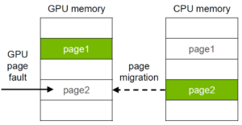
Kernel Execution Time
5.29×
Non-CC
Fig.3 Normalized kernel execution time.
Single Address Space
Frequent CPU-GPU interaction!
Source: NVIDIA
Introduction
Background
Performance Model
Evaluation
31
Conclusion
Notes:
Next we look at the base plus UVM case.
and we saw a 5.2 times increase on average.
This is expected from the UVM mechanisms.
So, what is UVM?
UVM provides you a single address space between CPU and GPU.
and you can trigger page migrations through page fault on GPU or CPU.
However, both page fault handling and migration are expensive.
So, UVM leads to frequent expensive CPU-GPU interactions.

Slide 32
Kernel Execution Time
5.29×
Non-CC
Fig.3 Normalized kernel execution time.
Single Address Space
Frequent CPU-GPU interaction!
ENC/DEC
Source: NVIDIA
With CC ON
Introduction
Background
Performance Model
Evaluation
32
Conclusion
Notes:
Which will be even worse under CC
the page migration will also trigger encryption and decryption transparently.

Slide 33
Kernel Execution Time
164,030.65×
5.29×
Non-CC
Fig.3 Normalized kernel execution time.
Introduction
Background
Performance Model
Evaluation
33
Conclusion
Notes:
Then how CC plus UVM looks like.
We quickly observed that it could reach up to 126,000 times increase in execution time.

Slide 34
Kernel Execution Time
164,030.65×
5.29×
188.87×
Non-CC
Fig.3 Normalized kernel execution time.
Introduction
Background
Performance Model
Evaluation
34
Conclusion
Notes:
and on average it contributes to a 188 times increase on execution time.

Slide 35
Kernel Execution Time
164,030.65×
5.29×
188.87×
Non-CC
Fig.3 Normalized kernel execution time.
Observation 3.
CC has minimal impact on non-UVM kernels (0.48% increase).
UVM in CC mode incurs an average slowdown of 188.87×.
Introduction
Background
Performance Model
Evaluation
35
Conclusion
Notes:
This finished our observation 3.

Slide 36
Memory Transfer Time
Pinned memory
Fig.4 Time (𝜇s) spent on memory copy.
Observation 4.
On average, copy operations in CC mode take 5.80× longer compared to non-CC mode, with a maximum slowdown of 19.69×.
Pinned memory is converted to UVM encrypted paging in CC mode which incurs high overhead.
Introduction
Background
Performance Model
Evaluation
36
Conclusion
Notes:
Then we look at memory transfer time.
Our observation here is on average copy operation in CC mode will take 5.8 longer compared to non-CC mode with a maximum slowdown of over 19 times.
as we mentioned before, pinned Memory is converted to UVM encrypted paging in CC, which also incur high overhead.

Slide 37
Launch and Queuing
Results are normalized to non-CC time.
5.31×
1.42×
1.43×
2.32×
Fig.5 Effect of CC on KLO, LQT, and KQT.
Introduction
Background
Performance Model
Evaluation
37
Conclusion
Notes:
Now we look at the launch and queueing overhead.
The impression here is CC will increase launch overhead and queueing times.
For example, CC could cause up to 5.3x increase in KLO

Slide 38
Closer Look
TD VM-Exit related
Shared memory related
Fig.6 Simplified call stack of a cudaLaunchKernel call, obtained via perf.
Observation 5.
On average, CC increases KLO by 1.42× mostly due to TDX hypercalls. It increases LQT by 1.43× and KQT by 2.32×.
For applications with a low number of kernel launches, KQT can be significantly amplified.
Introduction
Background
Performance Model
Evaluation
38
Conclusion
Notes:
For kernel launch, we can take a closer look
Here we show a simplified call stack of the launch call
<click>
We can observe that in CC, there will be some time spend on setting up shared memory, because this is required for communicating with external device
Which is also required by TDX isolation.
<click>
Then there is also context switch to handling communication via TDX hypercalls
<click>
Therefore, our observation here is
On average, CC increases KLO by 1.4 times mostly due to TDX hypercalls. It increases LQT by 1.4 times and KQT by 2.3 times.
For applications with a low number of kernel launches, KQT can be significantly amplified.

Slide 39
Case Study
Kernel
Σ(KET+KQT)
How long it takes (duration)
Σ(KLO+LQT)
Last Kernel
Launch
When it starts
Fig.7 Distribution of events and their durations for representative applications, in 𝜇s.
Introduction
Background
Performance Model
Evaluation
39
Conclusion
Notes:
Lastly, we put them together, and go through a case study
Here, 2 applications are shown with detailed event timeline
Two type of events are shown, namely Kernel Launch event and kernel execution event
To read this figure
<click>
First, the x-axis stands for when it starts
<click>
And the y-axis stands for how long it last (or the duration)
<click>
here the launch event for both non-CC and CC are shown
And kernel event are shown as well.
and an approximation of the total event duration can be viewed as the distance across the x-axis.
First, you can quickly observe that the CC launch duration increased. And this increase has different impacts to the last kernel finish time.
for application A, the last kernel finish time is not affected by launches.

Slide 40
Case Study
Kernel
Σ(KET+KQT)
How long it takes (duration)
Σ(KLO+LQT)
Last Kernel (Base)
Last Kernel (CC)
Launch
Increased cycles
When it starts
Dominated by Launch
Fig.7 Distribution of events and their durations for representative applications, in 𝜇s.
Introduction
Background
Performance Model
Evaluation
40
Conclusion
Notes:
However, for application B, we observed increased cycles in kernel finish time.
Due to the increased launch duration, the last kernel finish time is actually dominated by its last launch operation.

Slide 41
Case Study
Kernel
Fusion
Σ(KET+KQT)
How long it takes (duration)
Σ(KLO+LQT)
Last Kernel (Base)
Last Kernel (CC)
Launch
Increased cycles
When it starts
CC will delay the finish of kernels.
CC won’t delay the finish of kernels.
Dominated by Launch
Fig.7 Distribution of events and their durations for representative applications, in 𝜇s.
How to optimize?
Insights: Fusion and overlapping!
Introduction
Background
Performance Model
Evaluation
41
Conclusion
Notes:
Therefore we can conclude that for some applications like A
CC won't delay the finish of kernels.
but for some other applications like B.
CC Will delay the finish of kernels.
So how to optimize it?
our insights are, you can use fusion and overlapping.
Next, we briefly discuses the insight of fusion, more details can be found in the paper.

Slide 42
Insight: Fusion
CC-OFF
CC-ON
Launch a new kernel
shows high KLO.
Fuse 128 -> 1
First few launch
shows high KLO.
K₁
K₂
K₁
K₂
K₁
Aggressive fusion is not working, a right fusion parameter helps.
Introduction
Background
Performance Model
Evaluation
42
Conclusion
Notes:
Here we briefly describe the intuition.
we show kernel launch overhead of a simple 2 kernel scenario, where we launch k1 for 100 time, followed by K2 by 100 time, and we repeat this process.
First, we saw that launch a new kernel, always show a higher kernel launch overhead.
and first few launches to a new kernel shows also higher launch overhead.
With this heuristics, fewer kernel launches, often show extreme high kernel launch overhead
and there should be an optimization space where the number of launches could balance the KLO.
We fuse 128 kernels to one kernel gradually.
And here are the results showing the kernel launch overhead and launch queueing time respectively
We still see that when you do aggressively fusion like to one or 2 kernels, the kernel launch overhead is extremely high.
therefore aggressive fusion is not going to work. A right fusion parameter will help, and we leave this to our future work.

Slide 43

More Details
Memory Management
Kernel-to-Launch Ratio
Overlapping
CNNs
LLMs
Quantization
…
More details in the paper!
Introduction
Background
Performance Model
Evaluation
43
Conclusion
Notes:
And more details including CNNs, LLMs, quantization can be found in the paper. Please check it for more details.

Slide 44
Conclusion
We present a comprehensive performance evaluation of GPU-based CC guided by a simple performance model, and considered several optimizations towards addressing the overheads of CC.
Our results on real hardware show that GPU-based CC comes with:
Data movement: 5.80× (avg) 19.69× (max) 3.03 GB/s
Encryption: 3.36 GB/s (AES-GCM)
Kernel Execution: 0.48% (CC) 188.87× (avg, CC+UVM)
Kernel Launch: 1.42× (avg) 5.31× (max)
Queuing: 1.43× (avg, LQT) 2.23× (avg, KQT)
Introduction
Background
Performance Model
Evaluation
44
Conclusion
Notes:
To summarize,
We present a comprehensive performance evaluation of GPU-based CC guided by a simple performance model, and considered several optimizations towards addressing the overheads of CC.
Our results on real hardware show that GPU-based CC comes with different overhead across different components. The values are shown below.
and with all those information we can have a summary timeline figure showing that
the plain CC, came with encryption and Api of overhead.
When it turns to UVM it came with encrypted paging overhead, which largely slow down the application.
CC on GPU is a new topic recently, many explorations and optimizations are on the way, if you’re interested in it and want to play with it, I am happy to talk more off-line.

Slide 45
Thank You! Questions?
Dissecting Performance Overheads of
Confidential Computing in GPU-based Systems
Yang Yang, Mohammad Sonji, Adwait Jog
{yangyang, npv2tk, ajog} @virginia.edu
Notes:
Questions are welcome.
Thank you.

